Slide 1

MEDSBY BIOMECHX

Slide 2
INTRODUCTION
This product provides a webapp with a live line chart visualizing force over time.
There are buttons on the webpage. You can click 'Start Recording' to save the data. When you click 'Start Recording', the 'Stop Recording' button enables. You can then click 'Stop Recording' to stop saving the data. After you stop, the 'Stop Recording' button disables.
You can also click 'Save as CSV' to download the data as a file. Or, you can click 'Save as JPG' to download a picture of the chart.
SOFTWARE REQUIRED:
Arduino IDE
Web Browser
LittleFS Plugin
ESP8266 Board Support Package

Slide 3
SOFTWARE SETUP:
Download and install the Arduino IDE.
Enables the Arduino IDE to program the ESP8266 microcontroller using Board Manager.
Transfers webpage files to the ESP8266's file system using LittleFS Plugin.
Views the webpage and graph using web browser.
CODE EXPLANATION:
Include Libraries:
#include <ESP8266WiFi.h>
#include <ESP8266WebServer.h>
#include <LittleFS.h>
#include <DNSServer.h>

Slide 4
Global Constants: Wi-Fi credentials and the local domain name are defined.
const char* ssid = "Medsby-BiomechX";
const char* password = "12345678";
const char* domainName = "biomechx.local";
Global Objects: Web server and DNS server objects are created.
ESP8266WebServer server(80);
DNSServer dnsServer;
Global Variables: Variables for weight (kg) and CSV recording status are declared.
float weightKg = 0.0;
bool csvRecording = false;

Slide 5
Serial Initialization:
Serial.begin(9600);
Wi-Fi AP Setup:
WiFi.mode(WIFI_AP);
WiFi.softAP(ssid, password);
DNS Server Start:
dnsServer.start(53, domainName, WiFi.softAPIP());
LittleFS Initialization:
if (!LittleFS.begin()) {
Serial.println("LittleFS mount failed!");
return;
}
Define server routes for different URLs

Slide 6
404 handler for undefined routes is set:
server.onNotFound([]() {
server.send(404, "text/plain", "Not Found");
});
Web Server Start:
server.begin();
DNS Request Handling:
dnsServer.processNextRequest();
Serial Data Processing: The weight data received as string and converted to float.
Web Server Client Request Handling:
server.handleClient();

Slide 7
Set the CSV recording flag and sends a start message:
void handleStart() {
csvRecording = true;
server.send(200, "text/plain", "CSV recording started");
}
Clear the CSV recording flag and sends a stop message:
void handleStop() {
csvRecording = false;
server.send(200, "text/plain", "CSV recording stopped");
}

Slide 8
Generates the HTML web page with embedded JavaScript for the chart and data handling:
void handleRoot() {
….
server.send(200, "text/html", page);
}
Sends the weight data as a JSON response:
void handleData() {
float weightNewton = weightKg * 9.81;
String json = "{ \"value\": " + String(weightNewton, 2) + " }";
server.send(200, "application/json", json);
}
Serves static files from the LittleFS file system:
void handleFileRead(String path) {
String contentType = "text/javascript";
if (path.endsWith(".png")) contentType = "image/png";
else if (path.endsWith(".jpg")) contentType = "image/jpg";

Slide 9
if (!LittleFS.exists(path)) {
server.send(404, "text/plain", "File Not Found");
return;
}
File file = LittleFS.open(path, "r");
server.streamFile(file, contentType);
file.close();
}

Slide 10
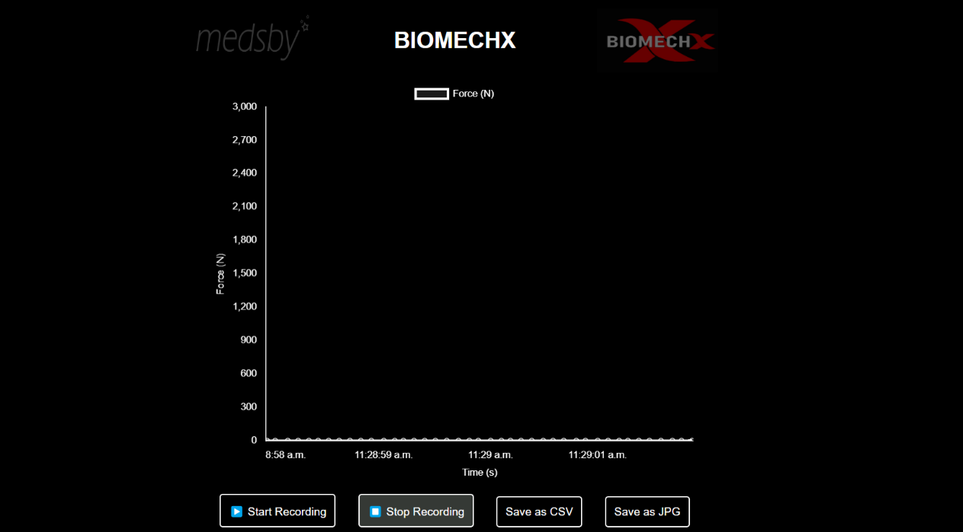
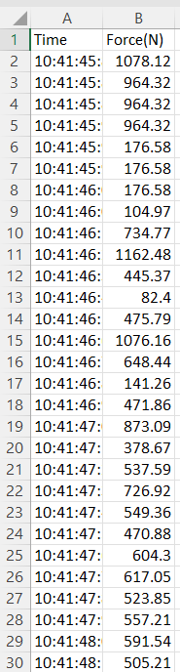
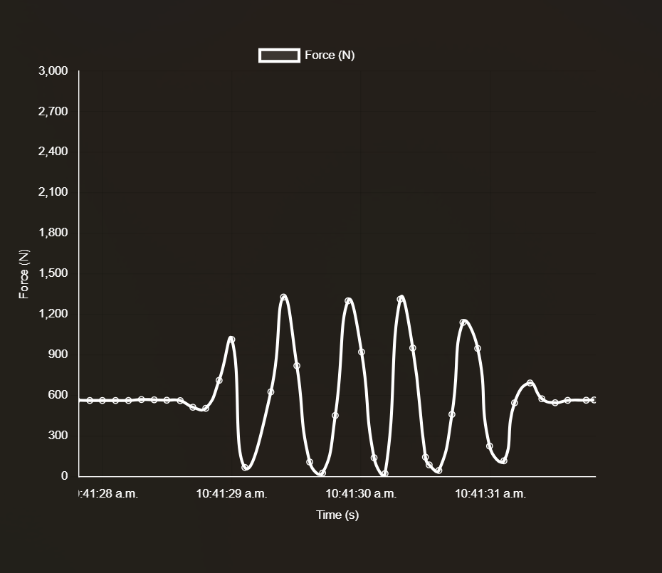
RESULT

Slide 11
THANK YOU

